Slide 1
Lecture 12: Placement – II
Tsung-Wei (TW) Huang
Department of Electrical and Computer Engineering
University of Utah, Salt Lake City, UT

Slide 2
In-class Presentation: 10/19
Floorplan research presentation on 10/19 (in class)
Xiaoping Tang and D. F. Wong, "FAST-SP: a fast algorithm for block placement based on sequence pair," IEEE/ACM Asia and South Pacific Design Automation Conference, 2001
Jackey Z. Yan and Chris Chu, “DeFer: Deferred Decision Making Enabled Fixed-Outline Floorplanning Algorithm,” IEEE Trans. Comput. Aided Des. Integr. Circuits Syst. 29(3): 367-381, 2010
Upload your pptx to https://github.com/tsung-wei-huang/ece5960-physical-design/issues/10 before presentation

Slide 3
Recap: Placement Problem
What does a placer do?
Input: Netlist of gates & nets
Output: Exact location of each gate
Goal: Able to route (connect) all wires
Placement is VERY HARD!
Bad placement → Much more wire
More wire: bigger, slower chip
If placement is very bad, next tool in the flow—the router—unable to connect all wires, or meet timing
Notes:
Last time we have talked about Placement – a very important stage in physical design, especially after the floorplan stage. Placement does the following job:
The placement problem is really difficult and very hard. In practice, we have to deal with large designs that contain 10—500M cells to place. If you have a bad placement, you will need much more wire to connect cells together described in nets. And we know the more complicated the wire, the more problems you will have, like longer delays, higher resistance, etc.

Slide 4
Recap: Placement Problem (cont’d)
Grid-based model of the chip
A simple grid – like a chess board
Cells (gates) go in grid slots
Pins (connect off-chip, fixed at edges)
Grid-based model of gates
All gates are exactly the same size.
(Unrealistic, but simplifies things)
Each grid slot can hold 1 gate
Any gate can go in any slot
Notes:
We also talked about how to model the placement problem so we can solve it computationally. We model the placement problem in a 2D grid. A simple grid, just like a chess board and you have many choices to place a chess on the board, and you know, a chess may connect to another so we want to minimize the complexity of interconnect.
So, we can regard each cell or gate to place like a chess going into a grid slot, and each gate has several pins to connect to other gates.
This grid-based model is not perfect but it is good for us to solve the problem computationally. Essentially, we assume gates are exactly of the same size and each grid slot can hold 1 gate. Yes, this is not realistic but it simplifies a lot of things.

Slide 5
Recap: Placement Problem (cont’d)
Placer optimizes the ability of router to connect all the nets
But routers are computationally expensive tools. We can’t run one “inside” placer
We need a simplified approximation at this stage
Every real placer minimizes expected wirelength
For each wire in the design, estimate the expected length of the routed wire
Minimize this objective: ∑_{wires Wi} EstimatedLength(Wi)
Placer finds gate locations to minimize this objective
Notes:
With this model, the goal of placement problem is to optimize the ability of router to connect all the gates together through nets. We also talked about, routers are computationally expensive tools, we can’t really run router inside the placer to estimate or evaluate the solution whether it is routable or not. So, we need a simplified approximation for Routability at this stage.
Every real placer minimizes the expected wirelength. (explain …)

Slide 6
Recap: Wirelength Estimation
Most placers adopt Half-Perimeter Wirelength (HPWL)
Also know as Bounding Box (BBOX) wirelength
Put smallest “bounding” box around all gates
Assume gate lives in “center” of the grid slot
Add width (∆X) and height (∆Y) of the BBOX for the wirelength estimate
A “2-point net”
A “4-point net”
y=5
4
3
2
1
0
y=5
4
3
2
1
0
∆X=3-1=2; ∆Y=4-1=3. HPWL=5
∆X=4-1=3; ∆Y=5-1=4. HPWL=7
x= 0 1 2 3 4
x= 0 1 2 3 4
Notes:
How do we estimate wirelength? Last time, we talked about that most placers adopt half-perimeter wirelength or the HPWL model to estimate the wirelength. HPWL is also known as bounding box wirelength because it puts the smallest bounding around all gates. (explain…)
For example, here I have a 6 by 5 grid and a 2-pin net. Gate 1 is sitting at (1, 4), x equal to 1 and y equal to 4. To calculate the bounding box (click), we find the width of the bounding box which is the largest x distance between gates, (explain …)

Slide 7
Recap: Wirelength Estimation (cont’d)
Easy to calculate, even for a multi-point net:
[max{X coordinates of all gates) – min{X coordinates of all gates}] + [max{Y coordinates of all gates) – min{Y coordinates of all gates}]
Always a lower bound on the real wire length
No matter how complex the final routed wire path is…
…you need at least this much wire to connect everything
Aside: all wiring on big chips (and most boards) is strictly horizontal & vertical – no “arbitrary angles” for manufacturing reasons which is another reason HPWL is good
Notes:
As you can see, HPWL is very easy to calculate, even for a multi-point net. The width of the HPWL is essentially the maximum x-distance among all gates, and the height of the HPWL is essentially the maximum y-distance among all gates. By summing the two value, we get the HPEL.
More importantly, HPWL is always a lower bound on the real wire length. And, this is a very strong property because it tells you the least amount of cost for completing something.
No matter how complex the final routed wire path is (explain …)

Slide 8
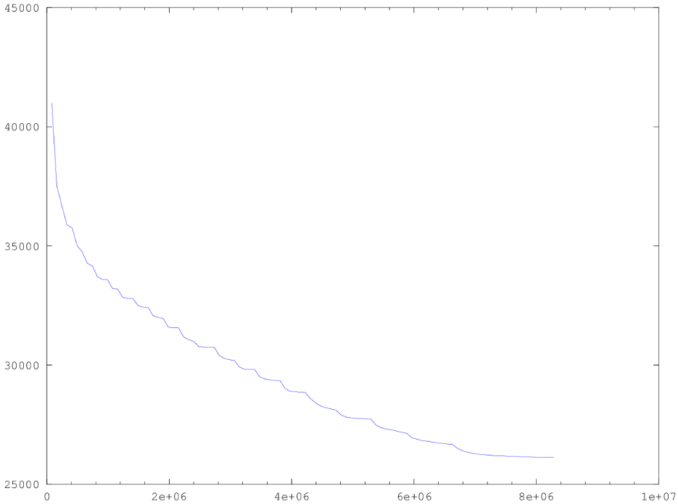
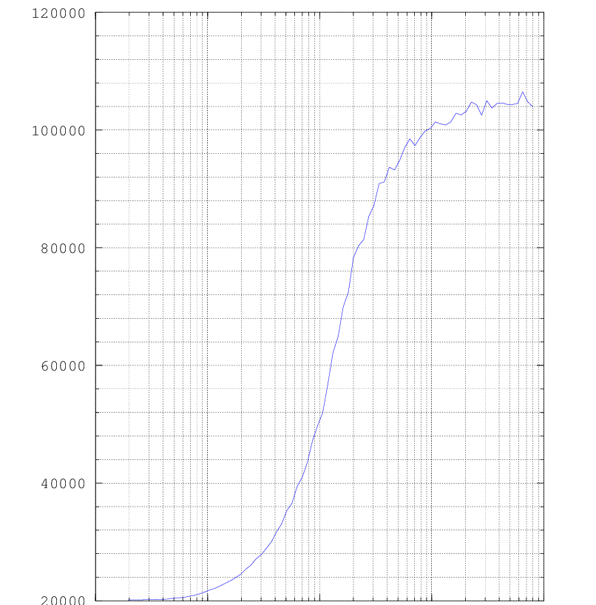
Recap: Placement Algorithm
Iterative Placer
(fast but bad quality)
∑HPWL
SA-based placer
(good quality but slow)
100K
80K
L = ∑_{nets Ni} HPWL(Ni)
60K
← Placer progress
40K
T→
20K
# random gate swaps→
0.1
1
10
100
1000
Notes:
Based on all these assumptions, last time we talked about two simple placement algorithms. Iterative placer and SA-based placer. Iterative placer uses a very simple idea of iteratively swapping cells to reduce the wirelength. At each iteration, you randomly pick up a pair of gates to swap. If such a swap can reduce the wirelength, you accept it.
This figure shows the result in terms of the number of random gate swaps. As we swap more gates, the wirelength keeps decreasing. Eventually, it stops at certain iterations. But, what is the problem of this greedy iterative swap-based placement algorithm?
To improve the solution from being too greedy, we have to tell ourself not to just accept a swap that results in a better solution, but accept a swap that results in a worse solution with certain probability. Basically, we want to be able to climb up so we can avoid being trapped by a local minimum. This can be solved using simulated annealing.
This figure shows the result of SA-based placer. (explain …)

Slide 9
Analytical Placer
Write an equation whose minimum is the placement
If you have a million gates, need a million (xi, yi) values as result
Formulate an appropriate cost function for all the gate-level (xi, yi): F(x₁, x₂, … x_{1M}, y₁, y₂, … y_{1M})
Solve analytically for X*=(x₁, x₂, … x_{1M}), Y*=(y₁, y₂, … y_{1M}) to minimize F(x₁, x₂, … x_{1M}, y₁, y₂, … y_{1M} )
The resulting values of X*, Y* give you the placement of all 1M gates
This sounds sort of crazy… but it works great
All modern placers for big ASICs and SOCs are “analytical”
Big trick is write the wirelength in mathematically “friendly” form we can optimize
Notes:
Any question so far?
Now, we are going to talk about analytical placer. We know both the greedy iterative placer and SA-based placer are not what a modern placer does, because both are too slow. Modern placers pretty much all adopt an analytical formulation to solve the placement problem.
An analytical placer writes an equation whose minimum is the placement. (explain …)
This sounds sort of crazy, right, for a placement problem of millions of gates, you will end up with millions of variables to optimize, but actually it works great. All modern placers for big ASIC and SOC are all analytical. The big trick is to write the wirelength in a mathematically friendly form we can optimize.

Slide 10
Key: Optimize Quadratic Wirelength Model
For 2-point net, we optimize squared length of “distance” line between points: (x1-x2)² + (y1-y2)²
A “2-point net”
Quadratic wirelength
=(3-1)² + (4-1)²
=13
y=5
4
3
2
1
0
BUT… what happens if your net has more than 2 points in it?
x= 0 1 2 3 4
Notes:
In most cases, when you hear “mathematically friendly”, it means quadratic. The key idea to analytical placer is to optimize quadratic wirelength model. We optimize the squared distance between gates.
For example, for 2-pin net, you know, a net that connects to only two pins or gates, we can write down the square length as follows: delta x square + delta y square
Here, I have a 2point net sitting in this 6 x 5 grid. Gate 1 is sitting at (1, 4), and gate 2 is sitting at (3, 1). What is the quadratic wirelength?
(click to show the answer)
(click to ask the question)

Slide 11
What About k-point Net, k>2?
Replace one “real” net with k(k-1)/2 2-point nets and add a new net between every pair of points–called a fully-connected clique model
A “k=4-point net”
Clique model
y=5
4
3
2
1
0
y=5
4
3
2
1
0
4
k(k-1)/2
=4(4-1)/2
=6 2-point nets
1
3
2
x= 0 1 2 3 4
x= 0 1 2 3 4
Notes:
So, what about a net that connects to more than two gates, or in general, the hypergraph connection. In this example, I have a 4-pin nets connecting to four gates, gate 1, gate 2, gate 3, and gate 4. Gate 1 is sitting on (1, 4), gate 2 is sitting on (3, 1), gate 3 is sitting on (3, 3), and gate 4 is sitting on (4, 5).
We can replace on real net with a complete graph such that all gates are connected to each other. And we know this results in n choose 2 connections, k(k-1)/2, in total. Essentially, we break the hyper graph to a normal graph such that every connection becomes a 2-pin connection.
So, in our example, that means I am introducing a two-point connection from 1 to 2, 1 to 3, and 1 to 4 (explain …). There are a total of 6 such connections. We take the square distance between each of them and add up the value to represent the square wirelength for this net.
But, what would be the problem?

Slide 12
What About k-point Net, k>2? (cont’d)
Each new 2-point net is weighted by 1/(k-1)
Why? 1 net became k(k-1)/2 nets. Need to compensate so we don’t “overestimate”
Note also: when k=2, this weight is just (2-1)=1, so no special treatment for common 2-point nets
Clique model
Quadratic estimate:
(1/3)[(4-1)² + (5-4)²]
+(1/3)[(4-3)² + (5-1)²]
+(1/3)[(3-1)² + (4-1)²]
+(1/3)[(3-1)² + (4-3)²]
+(1/3)[(4-3)² + (5-3)²]
+(1/3)[(3-3)² + (3-1)²]
=sum of 6 weighted 2-point lengths
y=5
4
3
2
1
0
x= 0 1 2 3 4
Notes:
Since you are breaking a hyperconnection into a two-pin connection, the result is a square complexity, right? It is k choose 2 which equal to k time k-1 divided by 2. You may overweight the square wirelength for nets that have many gates, because 1 net right now becomes k k-1 / 2 nets. We need to compensate it so we don’t over estimate the wirelength. A simple way to do this is to remove the k-1 fraction by dividing the total square wirelength by k-1.
In this example we saw from the previous slide, the 4-pin net is broken to 6 nets. And k-1 is 3, which is the factor we need to use to weight the squared wirelength. That gives the following result: (…)
Notice that, when k equals 2, this weight is just 1, so there is no special treatment for common 2-point net.

Slide 13
Gates as Points
To make the math work out easily, one more simplification:
Ignore the physical size of all the gate – pretend gates are dimensionless points
And, we will ignore (for now…) constraint that gates can’t go on top of each other
Sounds strange… Why?
Allow us to write a very simple, very elegant “equation” for the placement
Allow us to solve the problem very quickly and effectively

Slide 14
Easiest to See with Small Example
Chip surface is a rectangle
X from 0 to 1; Y from 0 to 1
This it totally arbitrary, btw
2 gate “points”, index 1 and 2
3 nets, each with a weight
Each net is 2 points to keep manual example small and easy
Weights are 1, 2, 4 in diagram
2 pads
Pad = fixed pin (red square) on the edge of the chip. These do not move.
(1,1)
Gate 2
4
(1,0.5)
Gate 1
2
1
(0,0)
Notes:
Let’s take a look at a small example. (explain )

Slide 15
Easy to Write the Quadratic Wirelength
(1,1)
4(x2-1)² + 4(y2-0.5)²
Gate 2: (x2, y2)
4
Gate 1: (x1, y1)
(1,0.5)
2
2(x2-x1)² + 2(y2-y1)²
1
(0,0)
1(x1-0)² + 1(y1-0)²
Next step: How do we optimize this equation?
Notes:
Then, we can easily write down the quadratic wirelength. The squared wirelength for the net of weight 4 is (explain …)
(ask student about nets 2, 1)
(click) How do we optimize this equation?

Slide 16
How Do We Minimize This?
Basic calculus! Differentiate, set derivative to 0, then solve!
But this is multiple variables? So, we do partial derivatives, set each to 0, solve x and y independently!
Q(X): 4(x2-1)² + 2(x2-x1)² + 1(x1-0)²
Q(Y): 4(y2-0.5)² + 2(y2-y1)² + 1(y1-0)²
∂Q/∂x1 = 0 + 4(x2-x1)(-1) + 2(x1)
= 6 x1 – 4 x2 = 0
∂Q/∂y1 = 0 + 4(y2-y1)(-1) + 2(y1)
= 4 y1 – 4 y2 - 8 = 0
∂Q/∂x2 = 8(x2-1) + 4(x2-x1) + 0
= -4 x1 + 12 x2 - 8 = 0
∂Q/∂y2 = 8(y2-0.5) + 4(y2-y1) + 0
= -4 y1 + 12 y2 - 4 = 0
Notes:
That is the basic calculus, right? If you want to find the minimum of something or a cost function, you just take the derivative and set the derivative to zero to find the roots. But here we have multiple variables, each gate has two variables, x and y, and we have millions of gates that result in millions of variables.
So, we can do partial derivatives, and set each to 0 to solve each variable independently!
(click and explain)

Slide 17
How Do We Minimize This? (cont’d)
These are linear equations! We know how to solve these!
Two matrix equations: Ax=b_{x} and Ay=b_{y} → N gates gives NxN matrix
Same matrix for X,Y, different b vectors → X, Y, b are Nx1 vectors
Q(X): 4(x2-1)² + 2(x2-x1)² + 1(x1-0)²
Q(Y): 4(y2-0.5)² + 2(y2-y1)² + 1(y1-0)²
Minimize
Minimize
6 -4
-4 12
x1
x2
0
8
6 -4
-4 12
y1
y2
0
4
=
=
x1 = 0.571 x2 =0.857
y1 = 0.286 y2 =0.429
Notes:
Then, these partial derivatives are just linear equations and we know how to solve linear equations! Since x and y are totally independent of each other, we can write down two matrix equations Ax=bx and Ay=by. N gates will give NxN matrix.
For example, the partial derivatives of x variables give two linear equations from x1 and x2. We can write down the equations as the following matrix. (explain …)
Similarly for x, the partial derivatives of y variables give two linear equations from y1 and y2. We can write down the equations as the following matrix (explain)

Slide 18
Placement Result
Observation: placement result makes visual sense!
All points on a straight line between the pads
Each 2-point wire is like a spring–placement minimizes all spring lengths
Bigger weight on the wire → shorter wire. Gives us lots of control over placement
Same matrix, different right-hand-side b vectors. Why? Different x, y pad coordinates
(1,1)
(1,1)
x1 = 0.571 x2 =0.857
2
4
y1 = 0.286 y2 =0.429
(1,0.5)
2
(1,0.5)
1
2
1
4
2
1
1
(0,0)
(0,0)
Notes:
If you look at this result, it actually makes sense! All points sit on a straight line between the square pads. Each 2-point wire is like a spring and the placement optimization minimizes all spring lengths!
Also, if you put a bigger weight on the wire, it gives you a shorter wire. That gives us a lot of control over placement to tune the distance between gates, right?

Slide 19
What is Matrix A? (cont’d)
Surprisingly simple recipe to build the required A matrix
First, build the NxN connectivity matrix, called C
If gate i has a 2-point wire to gate j with weight w, c[i,j] = w, else = 0
Another example of 3 gates, 3 wires, and 1 I/O pad (P)
5
P
1
1
2
C =
0 1 0
1 0 4
0 4 0
4
Note: C matrix ignores the pads
3
Notes:
Of course, we derive the matrix by hand, you know, Ax=bx and Ay=by. But, how do we calculate the matrix systematically? (explain..)
For example, here I have a placement problem of three nets and three gates, and one pad. Keep in mind, pad is a fixed element in the placement region that cannot be moved. Gates 1, 2, 3, are to be moved to minimize the wirelength.
Here I have three nets, quite simple, all 2-pin nets. Net one has a weight of 5 connecting gate 1 to the pad (explain …)
The C matrix for this example is as follows. It’s a square matrix, each column and row index represent the gate. Basically it is adjacency matrix. As long as there is a connection between gates, we will put the weight of its net.

Slide 20
What is Matrix A?
Use the connectivity C matrix to build A matrix
Elements a[i,j] not on the matrix diagonal are just a[i,j] = -c[i,j]
Elements on the diagonal are a[i,j]= ∑_{j=1,n} c[i,j] + (weight of any pad wire)
…ie, add up the i^{th} row of C and then add in weight on a (possible) wire to pad
Note: A matrix accounts for pads
5
P
1
1
2
C =
0 1 0
1 0 4
0 4 0
A =
6 -1 0
-1 5 -4
0 -4 4
4
3
diagonal
Notes:
Then, what is the matrix A? Well, we use the connectivity C matrix to build A matrix. (explain…)

Slide 21
What is Vector b?
i
wi
(xi,yi)
For Ax = b_{x} vector:
If gate i connects to a pad at (xi, yi) with a wire with weight wi
Then set b_{x}[i] = wi • xi
For Ay = b_{y} vector:
If gate i connects to a pad at (xi, yi) with a wire with weight wi
Then set b_{y}[i] = wi • yi
A
x
=
b_{x}
A
y
=
b_{y}
i^{th} element of b_{x} vector
i^{th} element of b_{y} vector
Notes:
Now, we are good for the square matrix A. What is the vector b? (explain Ax=bx and Ay=by)

Slide 22
How to Solve Ax=b?
Are these difficult to do, in practice?
If we have 1M gates, this is a 1M x 1M A matrix, with 1M element x and b vectors!
No – these are VERY EASY to solve, even when very large
The A matrix has a special form—it is sparse, symmetric, diagonally dominant
Mathematically: A is positive semi-definite—very simple to solve!
We use iterative, approximate solvers, in practice (i.e., not Gaussian elimination but techniques like conjugate gradient)
This means the solver converges gradually to the right answer
But, also means that the answers can be a little bit “off”, not quite perfect
Notes:
Now we have the matrix A and b, a linear system described in matrix form. How do we solve it? You know the matrix is pretty big in practice, for example, if we have 1M gates, this is a 1M by 1M matrix in A with 1M element x and b vectors, same for y!
Well, turns out these are not difficult at all, thanks to the advancement of computing, these equations are very easy to solve, even when the problem is very large. (explain …)

Slide 23
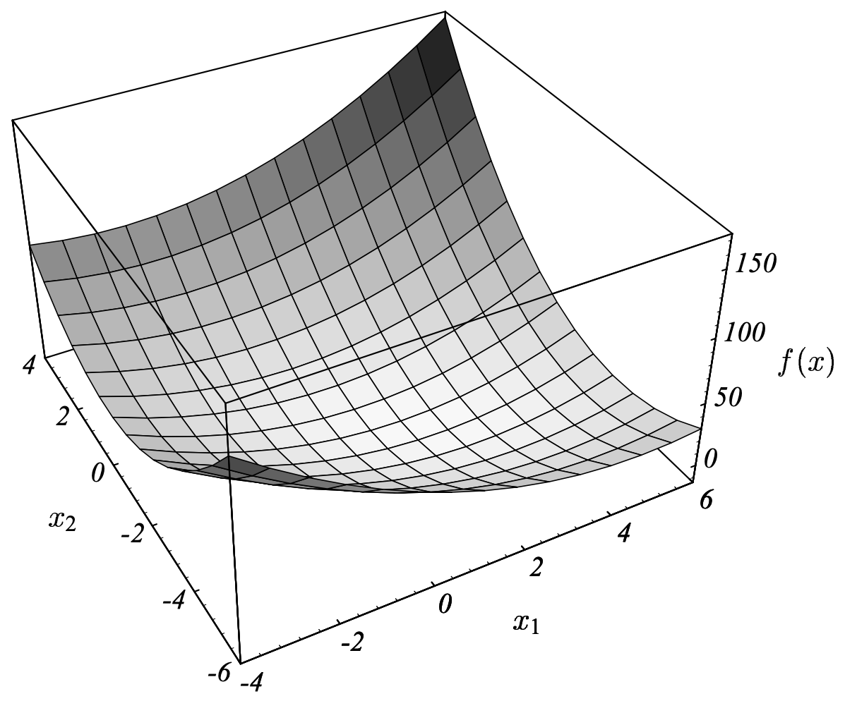
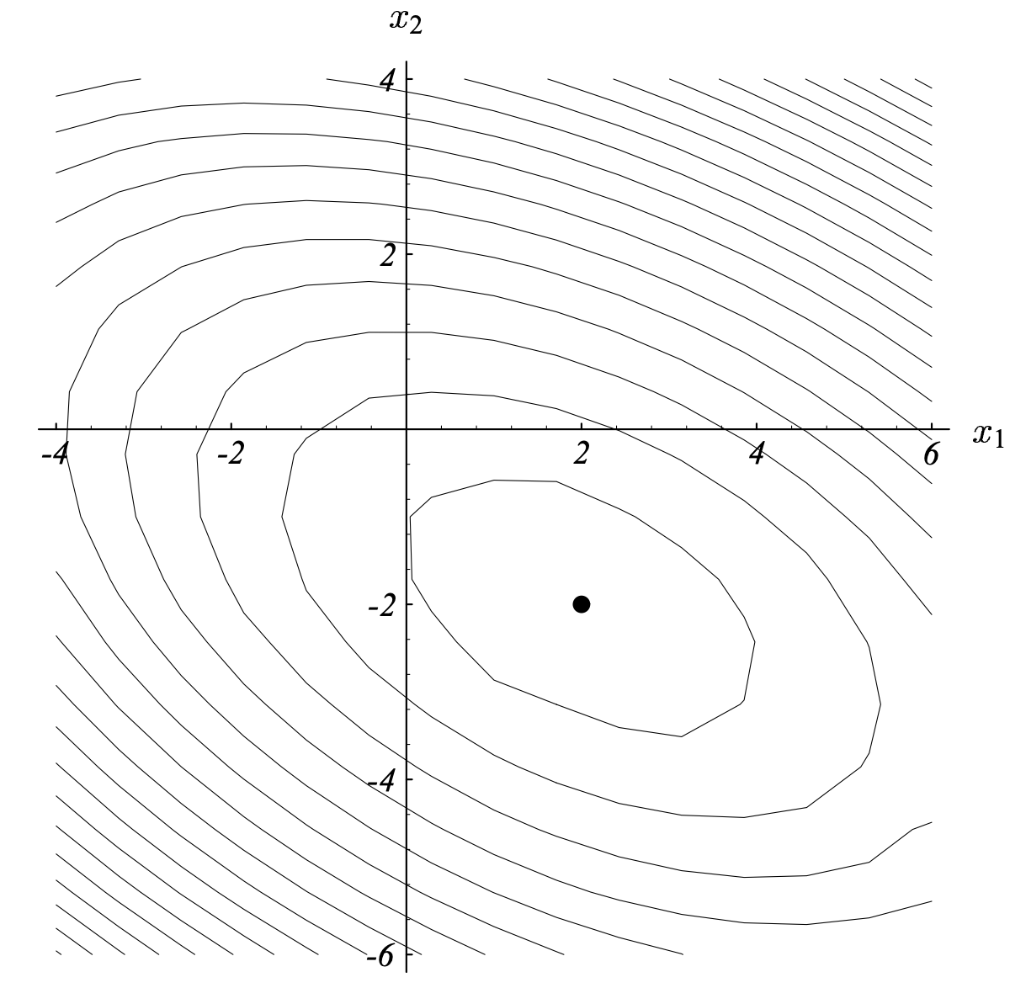
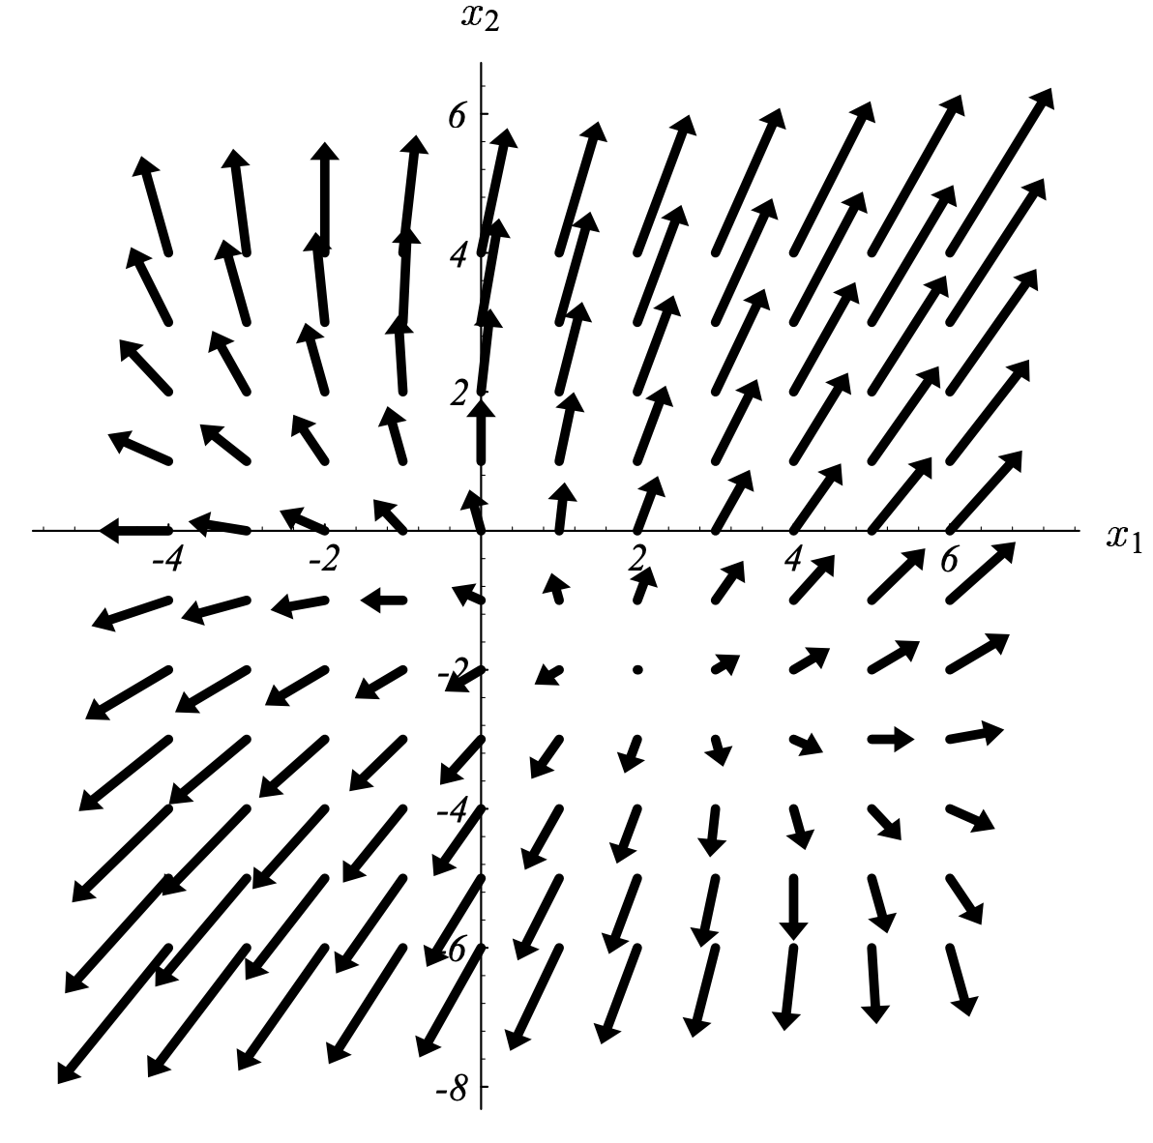
Conjugate Gradient
Practical analytical placers apply conjugate gradient
https://www.cs.cmu.edu/~quake-papers/painless-conjugate-gradient.pdf
Notes:
And, there is a very nice article about how to solve the placement problem using conjugate gradient, written by a professor at CMU. You can find more details about the method in this link below.

Slide 24
Another Example – Building A
(0, 1)
(1,1)
1
0 1 10 0 0
1 0 1 1 1
10 1 0 1 0
0 1 1 0 1
0 1 0 1 0
21 -1 -10 0 0
-1 4 -1 -1 -1
-10 -1 13 -1 0
0 -1 -1 4 -1
0 -1 0 -1 3
3
C =
A =
4
Weight=10
5
2
Weight=10
Elements a[i,j] not on the matrix diagonal are just a[i,j] = -c[i,j]
Elements on the diagonal are a[i,j]= ∑_{j=1,n} c[i,j] + (weight of any pad wire)
(1,0)
(0.5,0)
All wire weights = 1 except two highlighted:
gate1 to pad and gate1 to gate2
Notes:
Let’s take a look at another example to illustrate how we can construct the matrix C, A, bx and by. Here I have a placement of five gates to place, and they are connected to four pads that are fixed at the chip boundary. The net connecting gate 1 and the pad 1 here is of weight 10, and the net connecting gate 1 and gates is of weight 10 as well. All the other nets have unit weights of one.
Let’s start with building the matrix A. In order to build A, we need the connectivity C first. We know C is essentially the adjacency matrix that describe the weight between gates. For example, the first row of C is 0, 1, 10, 0, 0. The only two non-zero entries are 1 and 10 on the second and the third column. So, that means gate is connects to gate 2 and gate 3 with net weight 1 and 10.
(ask student about the next rows)

Slide 25
Another Example – Building b
(0, 1)
(1,1)
For Ax = b_{x} vector (similarly for y):
If gate i connects to a pad at (xi, yi) with a wire with weight wi
Then set b_{x}[i] = wi • xi
1
3
4
Weight=10
5
2
Weight=10
b_{x} = 0
0
1
1
0.5
b_{y} = 10
0
0
1
0
(1,0)
(0.5,0)
All wire weights = 1 except two highlighted:
gate1 to pad and gate1 to gate2

Slide 26
Another Example
(0, 1)
(1,1)
1
0 1 10 0 0
1 0 1 1 1
10 1 0 1 0
0 1 1 0 1
0 1 0 1 0
21 -1 -10 0 0
-1 4 -1 -1 -1
-10 -1 13 -1 0
0 -1 -1 4 -1
0 -1 0 -1 3
3
C =
A =
4
Weight=10
5
2
Weight=10
b_{x} = 0
0
1
1
0.5
b_{y} = 10
0
0
1
0
(1,0)
(0.5,0)
All wire weights = 1 except two highlighted:
gate1 to pad and gate1 to gate2
Notes:
So, this is the matrices we have constructed for this example. Then, we can call a linear system solver to solve the linear system and acquire the values for all the variables x and y.

Slide 27
Another Example: Result
Notes:
Here is the solution. Kinda make sense, we see a shorter connection for net of high weight like the connection between this pad and the gate 1 here, and so on so forth.
Now, we have successfully transformed the placement problem to solving linear equations that optimize the quadratic wirelength. Here I have two questions.
#1: what is the purpose of quadratic? Why don’t we take cube or 4 or 5.
#2: what is the problem of this solution?

Slide 28
Summary
We have discussed a new analytical placement algorithm
We have discussed the quadratic wirelength model
Construct the matrix A (NxN) for a placement problem of N gates
Construct the vector b_{x} and the vector b_{y}
Formulate the placement problem into a linear system
Solve the linear system and get the gate locations
We will dive into the quadratic placement problem next

